Slide 1
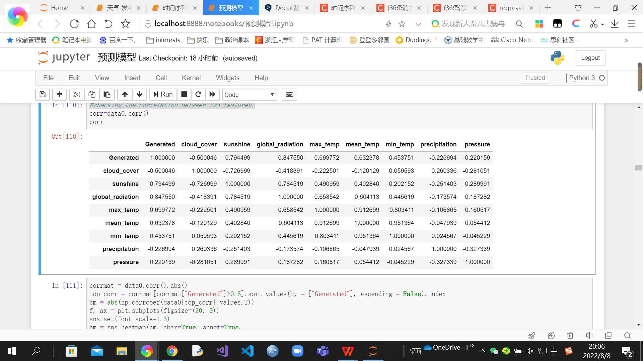
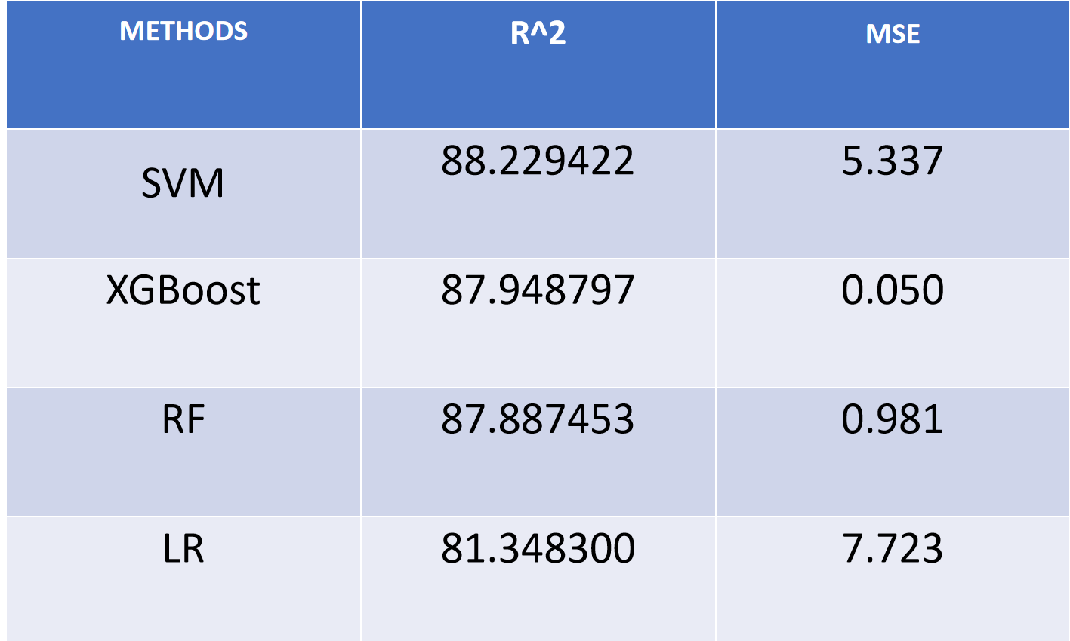
Solar Panel Energy Prediction Study
Group member: Kezhen Chen(3190102665@zju.edu.cn), Hanwen Li (hal153@pitt.edu)
Professor: Majed Al-Ghandour (mnalgha@ncsu.edu)
Solar panels are now a popular alternative to conventional electricity. The research is conducted to decide whether solar panels are a better choice when all economic costs are considered.
XGB and RF model have the best prediction
performance in this case with insolation
incident, precipitation, relative humidity
and temperature playing a significant
impact on the total amount of electricity
produced by solar panels.
• Net value of total production is affected
by the cost of the solar PV system, the
value of electricity, incentives and so on.
• As the costs for PV solar is rapidly
declining and a lot of incentives are enacted,
it will be a wise choice to invest in solar
panels in the future.
PURPOSE
PRODUCT & RESULT
CONCLUSION
Task 1. Data Collection & Processing
Table1: the correlation between weather features
Data:
Solar energy generation of a system.
Weather.
Price of a solar panel system.
Prices of traditional electricity.
Set up the data environment, including data preparation, data cleaning and feature selection of weather data to prepare for modeling.We collect data from London, UK for the years 2016 to 2020.
INTRODUCTION
Solar energy is now considered to be an environmentally friendly, safe and reliable energy source. Since solar energy mainly relies on sunlight for power generation, it is objectively affected by weather (such as precipitation, snowfall, etc.) and the length of daylight hours in the region. And its low energy conversion rate, short service life and high price make solar energy not widely used. We hope to help individuals or companies in the London area advise on whether to install solar panels in a reasonable way.
Task 2. Energy Prediction Model
Photovoltaic power potential is closely related to weather. Based on the machine learning algorithm method, we find the degree of influence of different factors on power generation and find the best model for simulated prediction of power generation
Predicting solar power generation from weather, the XGBoost modle performs better than support vector machine and linear regression .
FUTURE
Collect more precise and regionally segmented weather data.
Use advanced models for regression prediction of solar power generation in different types of buildings when forming decision support systems.
Accurately predict conversion efficiency, equipment life, and cost changes.
METHODOLOGY
Finding factors that influence the production of a photovoltaic system.
Developing machine learning algorithms to predict energy generation with the weather.
Applying Investment return analysis to give this investment a reasonable evaluation.
Task 3. Return on Investment Analysis
REFENERCE
The address of the solar panel that generates the data we use is near London Heathrow Airport. We calculate the price and installation cost of this solar panel and calculate a payback period of 15 years by projecting the amount of electricity generated in future years and the expense of conventional electricity. We did not take into account other costs such as equipment damage and maintenance.
https://www.gov.uk/government/statistical-data-sets/prices-of-fuels-purchased-by-manufacturing-industry
https://pvoutput.org/
https://www.solarreviews.com/solar-panel-cost

